Slide 1

Storage
Account

Slide 2
Storage Account:
Microsoft Azure's storage solution for object storage, file storage, message queue and a NoSQL store for meeting modern application requirements
High availability and durability Storage account comes with different redundancies to fulfill your durability requirements. Data stored in the storage account can be replicated to different datacenters and even across regions ensuring high availability for the data
Scalability and Managed Azure Storage is a platform managed service, depending upon the requirement it will automatically scale the storage and performance
Security By default, all data written to the storage account is encrypted by Storage Encryption Service. To access the data storage accounts, provide different authorization methods such as storage keys, shared access signature, and Azure AD
Access HTTP or HTTPS can be used to access the data that is stored in Azure Storage. With the help SDKs provided by Microsoft, developers can easily integrate Azure Storage with their code. Azure Storage also supports Azure PowerShell, Azure CLI and REST API

Slide 3
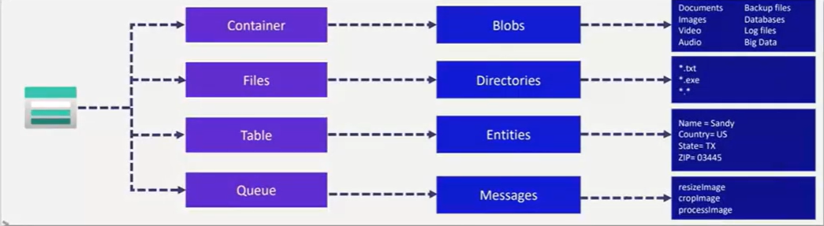
Azure Containers Ideal for storing unstructured data such as text or binary data
Azure Files Used to provision highly available file shares in cloud that can be mounted to cloud and on-premises machines
Azure Tables Ideal for storing structured non-relational data
Azure Queues Used to store messages and retrieve messages between application components that needs to be processed asynchronously

Slide 4
Storage Replication
Locally redundant storage (LRS) LRS: Synchronously replicates data to three disks within a data center in the primary region. Offers a moderate level of availability at a lower cost.
Zone-redundant storage (ZRS) ZRS: Synchronously replicates data among three Azure availability zones in the primary region. Provides a higher level of resilience at higher cost.
Geo-Redundant storage (GRS) GRS: Stores another three copies of data in a paired Azure region.
Read-Access Geo-Redundant (RA-GRS) RA-GRS: Same as GRS, but allows data to be read from both Azure regions.

Slide 5
Version
Control

Slide 6
Version Control
Version control, also known as source control, is the practice of tracking and managing changes to software code
Version control software keeps track of every modification to the code in a special kind of database
Version control tracks every developer change and helps prevent concurrent work from conflicting
Benefits of the version control system:
Enhances the project development speed by providing efficient collaboration
Reduce possibilities of errors and conflicts meanwhile project development through traceability to every small change
Employees or contributors of the project can contribute from anywhere irrespective of the different geographical locations through this VCS
For each different contributor to the project, a different working copy is maintained and not merged to the main file unless the working copy is validated. The most popular example is Git, Helix core, Microsoft TFS
Helps in recovery in case of any disaster or contingent situation
Informs us about Who, What, When, and Why changes have been made

Slide 7
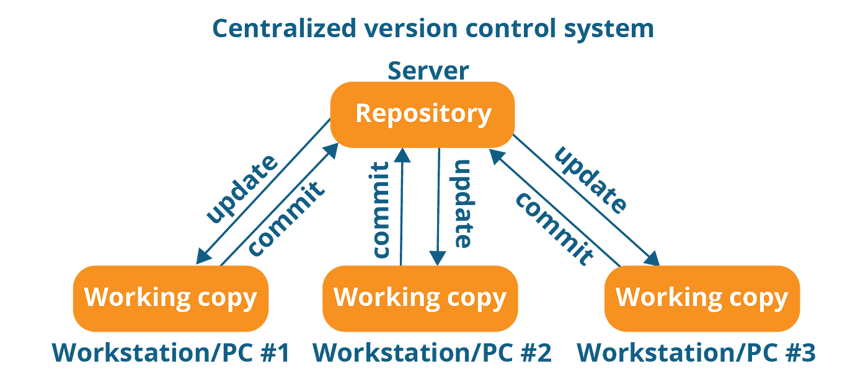
Centralized Version Control Systems
Centralized version control systems contain just one repository globally and every user needs to commit to reflecting one's chances in the repository. It is possible for others to see your changes by updating.
Two things are required to make your changes visible to others which are:
You commit
They update

Slide 8
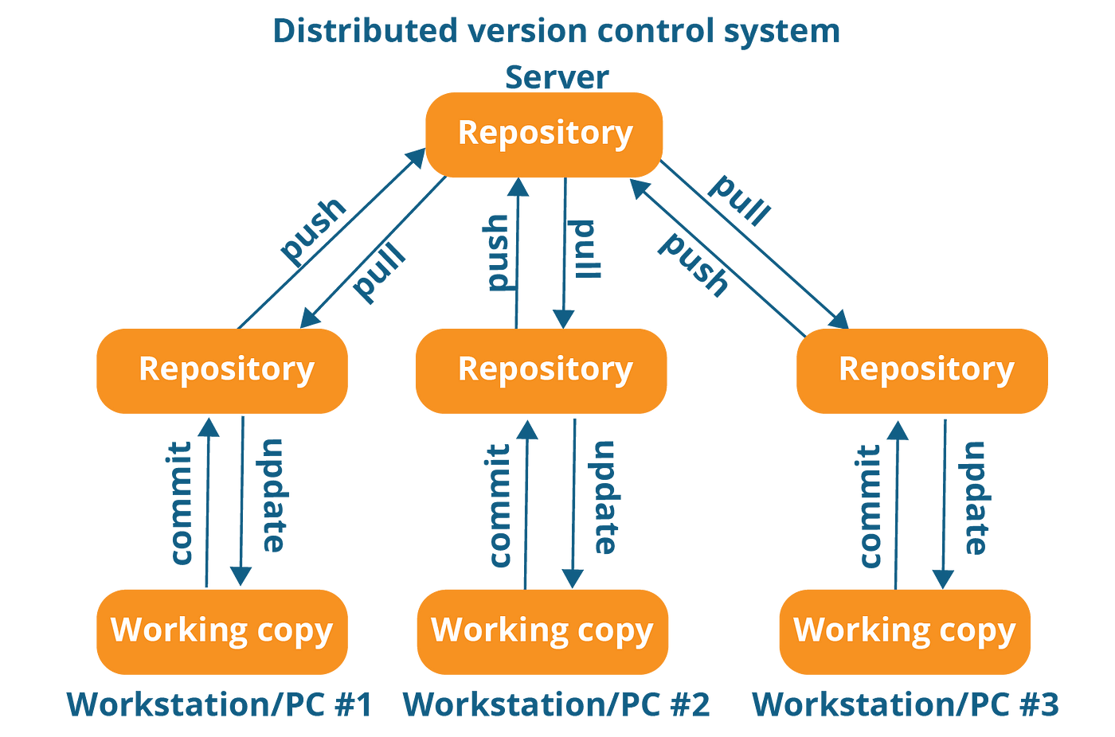
Distributed Version Control Systems:
Distributed version control systems contain multiple repositories
Each user has their repository and working copy, users need to pull to fetch the latest changes whereas developers need to push their changes to update the remote repository
To make your changes visible to others, 4 things are required:
    You commit
    You push
    They pull
    They update

Slide 9
Benefits of using GIT over SVN/TFS
Git utilizes multiple repositories: a central repository and a series of local repositories. Local repositories are exact copies of the central repository complete with the entire history of changes, Unlike SVN
The Git workflow is similar to SVN, but with an extra step: to create a new feature, you take an exact copy of the central repository to create your local repository on your local machine
Many developers prefer GIT for the following reason:
  Its faster to commit
  No more single point of failure
  If the centralized server is down, the developers can still work using a local copy
  It's available offline
TFS works on the concept of By Value whereas GIT works on the concept of By Reference
  This means in TFS, the total number of branches = total number of physical folders
  GIT, the total number of branches = Branches are logical and only the reference or pointer moves ahead or back with each branch

Slide 10
GIT Introduction
Git is a fast, scalable, distributed revision control system with an unusually rich command set that provides both high-level operations and full access to internals.
Distributed VCs:
Distributed version control (also known as distributed revision control) is a form of version control in which the complete codebase, including its full history, is mirrored on every developer's computer.
It enables automatic management branching and merging speeds up most operations (except pushing and pulling), improves the ability to work offline, and does not rely on a single location for backups.

Slide 11
Agent Pools

Slide 12
Agent Pool:
To build your code or deploy your software using Azure Pipelines, you need at least one agent. As you add more code and people, you'll eventually need more.
When your pipeline runs, the system begins one or more jobs. An agent is computing infrastructure with installed agent software that runs one job at a time.
Microsoft-hosted agents:
If your pipelines are in Azure Pipelines, then we got an option to run our jobs using a Microsoft-hosted agent.
With Microsoft-hosted agents, maintenance and upgrades are taken care of for us. Each time we run a pipeline, we get a fresh virtual machine for each job in the pipeline.
Self-hosted agents:
An agent that you set up and manage on your own to run jobs is a self-hosted agent.
Self-hosted agents give you more control to install dependent software needed for your builds and deployments.

Slide 13
ARM Templates

Slide 14
Benefits of ARM Templates
Declarative automation: ARM templates use JSON files. In declarative automation, you need to declare the resources but not how to create them. Creating the resources is Resource Manager's responsibility.
Consistent and reusable: Environments deployed via ARM template will be consistent. With the help of parameters, We can share and reuse the template to create an environment from scratch.
Error-prone tasks and simplified deployment: If we are creating an environment manually chances of human error will be there and with ARM templates, we can deploy all the resources we define in a single operation
Linkable and helps complex deployment: You can write small ARM templates and link them to a parent template. This helps in managing different parts of the template efficiently. With ARM templates, we can deploy complex environments in the correct dependency order.

Slide 15


ARM Template Composition
schema: References the location of the JSON file schema that describes the version of the template language. We can deploy ARM templates to different scopes like tenants, management groups, and subscriptions; based on the scope that we are selecting the schema will change.
Content Version: Used to version the template, the default value is 1.0.0.0. Any value can be given to this element. Content version is useful if you are storing your templates in source control and would like to keep the changes tracked in different versions. Proper versioning will help users to pick the latest version of your template.

Slide 16
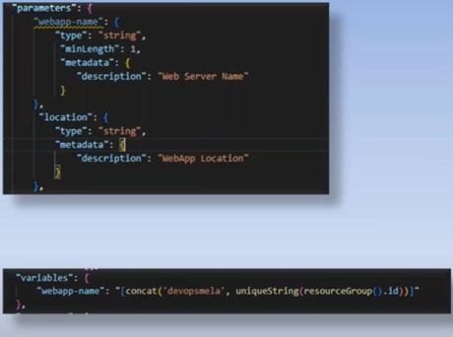
ARM Template Composition
Parameters:
During resource deployment, the parameter value can be provided as input to the template. Parameters help making the templates reusable, where users can supply different values during execution without the need to modify the template.
Variables:
Variables can be used to hardcode values to the templates. If you are referencing a value with the help of variables and if that value needs to be modified; instead of updating all occurrences, you just need to update the value of the variable.

Slide 17
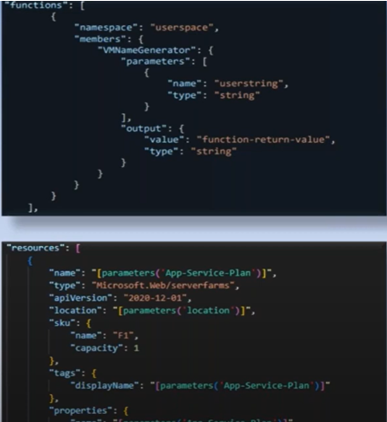
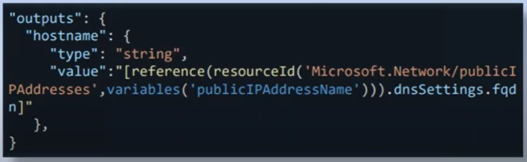
ARM Template Composition
Functions:
We can create user-defined functions in ARM templates that can be used to replace repeated code blocks.
Resources:
Resources we intend to create, or update will be declared inside this element. Here, we can reference the parameters, variables, and functions we created earlier.
Outputs:
Display values that are returned after deployment.

Slide 18
Bicep

Slide 19
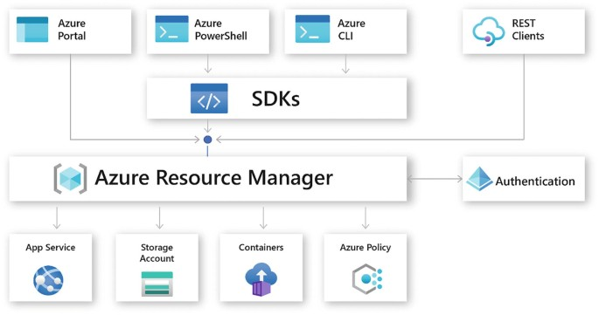
ARM Archiecture

Slide 20
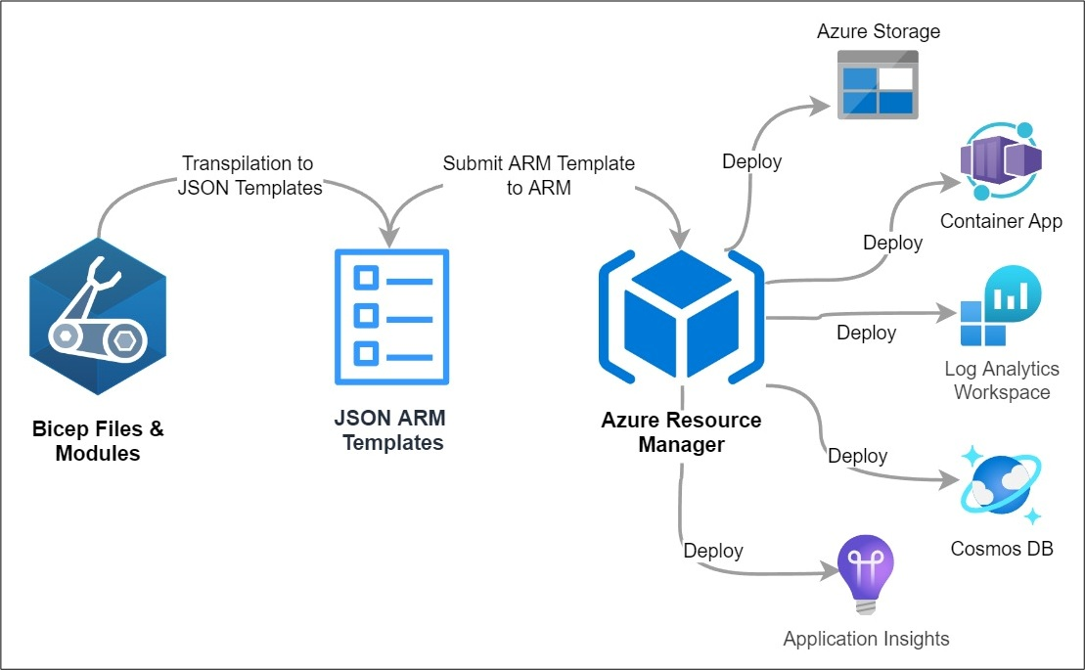
Bicep

Slide 21
Relationship Between Bicep & Azure Resource Manager
Azure Resource Manager (ARM)
ARM is the brain of Azure.
It deploys, manages, and configures all Azure resources.
ARM templates (JSON) are the language ARM understands.
Your Code → Bicep File (.bicep)
↓ (automatically converted)
ARM Template (.json)
↓
Azure Resource Manager
↓
Azure Resources Deployed
Where does Bicep come in?
Bicep is a simplified language for ARM.
ARM only understands JSON, but JSON is:
  👉 Hard to write
  👉 Hard to read
  👉 Hard to maintain
So Microsoft built Bicep:
You write Bicep code
Bicep automatically converts to ARM JSON
ARM deploys to Azure

Slide 22
Bicep Provides
Automation
Manual portal clicks → slow, error-prone
DevOps requires repeatable deployments (CI/CD)
Bicep files can be executed automatically using:
  Azure DevOps Pipelines
  GitHub Actions
  Scripts (Azure CLI / PowerShell)
Reusability
Same template can deploy:
  Dev, QA, UAT, Prod
  Multiple subscriptions / customers
Use parameters, modules, loops to reuse logic
Standard architecture patterns (e.g., AKS, Networking) can be packaged as modules
Version Control
Portal changes are not tracked
Bicep code is stored in Git
You get:
  Change history
  Collaboration (PR reviews)
  Rollbacks (if deployment breaks)
  Approval workflow for production
Zero Human Mistakes
Portal allows misclicks → wrong region, wrong SKU, security gaps
Bicep enforces:
  Consistent naming conventions
  Locked configurations
  Validations before deploy (“what-if”)

Slide 23
Bicep Benefits
Feature | GUI (Portal) | Bicep
Speed | Slow & manual | Fast & automated
Repeatability | Hard to repeat | 100% repeatable deployments
Consistency | Human errors likely | Consistent + version-controlled
Multi-environment | Difficult (Dev/QA/Prod) | Easy by using parameters
Collaboration | Not ideal | Teams collaborate via Git
Compliance | Manual validation | Policy-enforced & auditable
Automation | Limited | Fully automatable CI/CD

Slide 24
Bicep Template Composition
Block | Purpose
param | Input values for flexible deployments
var | Store intermediate values / reusable expressions
resource | Define Azure resources to be deployed
module | Reuse other Bicep templates (modular IaC)
output | Return values from deployment (like connection strings, resource IDs)
targetScope | Define deployment scope (resource group, subscription, MG, tenant)

Slide 25
targetScope = 'resourceGroup'
@description('Name of the Storage Account')
param storageAccountName string
var skuName = 'Standard_LRS'
resource storageAccount 'Microsoft.Storage/storageAccounts@2023-01-01' = {
name: storageAccountName
location: resourceGroup().location
sku: {
name: skuName
}
kind: 'StorageV2'
}
output storageId string = storageAccount.id
Defines where the template will be deployed.
Used to inject values → good for Dev / Test / Prod flexibility.
Variables - Reusable expressions
Defines the exact Azure resource to create.
Returns useful values from the deployment.

Slide 26
YAML
Scripts

Slide 27
YAML
Data Serialization:
Data serialization is the process of converting data objects present in complex data structures into a byte stream for storage, transfer, and distribution purposes on a physical device.
Example: Serialization is when reading data from databases and transferring it across the web.
Some commonly used serialization formats are JSON, YAML, XML.
YAML:
YAML is a data serialization format that stands for YAML Ain't Markup Language.
YAML is written in simple English and is easier for humans to read and write.
YAML supports various data types like cases, arrays, dictionaries, lists, and scalars.
It has good support for the most popular languages like JavaScript, Python, Ruby, Java, etc.
YAML only supports spaces, and it is case sensitive as well as space sensitive.
Tabs are not accepted universally. A YAML file has a .yaml extension.

Slide 28
YAML
Mapping:
The mapping syntax is key: value. (Note the space, it's very crucial in YAML, unlike JSON or XML)
name: Bharath Reddy
age: 35
location: Hyderabad

Slide 29
YAML
YAML also supports data types like characters, strings, integers, floating values, and collections like arrays, lists that are constructed from basic data types
NAME: “Bharath Reddy" ------> String
MALE: FALSE ------> Boolean
Amount: 120.30 ------> Float
Concern: NULL ------> Null
AGE: 16 ------> Integer

Slide 30
YAML
List
Nested list
Nested Dictionary
---
student: "john"
hobbies:
music
Reading
dancing
---
student2:
fatherName: "Grey" motherName: "Winey" subjectDetails:
subject1: 70
subject2: 100
---
apple
banana
mango

Slide 31
Maven

Slide 32
Maven
Mavn:
Maven is a powerful project management and build automation tool used primarily for Java applications.
It simplifies the process of:
  Building Java projects
  Managing dependencies
  Creating documentation
  Running test plans
  Packaging and deploying applications
Maven is widely used in enterprise Java environments for its standardization and ease of configuration via XML.

Slide 33
POM.xml
POM stands for Project Object Model.
It is an XML file (pom.xml) located at the root of a Maven project.
It contains information about the project and configuration details used by Maven to build the project.
Key contents:
  Project metadata: groupId, artifactId, version
  Project dependencies (external libraries)
  Plugins
  Build profiles
  Lifecycle and goals

Slide 34
POM File
<project xmlns="http://maven.apache.org/POM/4.0.0"
xsi:schemaLocation="http://maven.apache.org/POM/4.0.0
http://maven.apache.org/maven-v4_0_0.xsd">
<modelVersion>4.0.0</modelVersion> <!-- Specifies the model version -->
<groupId>com.mycompany.app</groupId> <!-- Specifies project group ID -->
<artifactId>my-app</artifactId> <!-- Specifies project artifact ID -->
<packaging>jar</packaging> <!-- Defines packaging type (jar, war, etc.) -->
<version>1.0-SNAPSHOT</version> <!-- Project version -->
<name>my-app</name> <!-- Name of the Maven project -->
<url>http://maven.apache.org</url> <!-- Project or organization URL -->
</project>

Slide 35
SonarQube
Static Application Security Testing

Slide 36
SonarQube
SonarQube is an open-source platform developed by SonarSource for continuous inspection of code quality to perform automatic reviews with static analysis of code.
Why?
It helps in detecting areas in the code that needs refactoring or simplification
It can help to find the bug early in the development cycle, which means less cost to fix them
We can define project-specific rules which will then be implemented without manual intervention
What?
Simply having visibility into code is not enough and in order to address the issues flagged by code analysis, we need to make use of different data insights that we get from SonarQube
How?
Quality Gates
Best way to ensure that standards are met and regulated in projects
Can be defined as a set of threshold measures set on your project

Slide 37
Azure Artifact

Slide 38
Artifact
Azure Artifacts is an extension that makes it easy to discover, install, and publish NuGet, npm, and Maven packages in Azure DevOps. It’s deeply integrated with other hubs like Build so that package management can become a seamless part of your existing workflows.
Keep your artifacts organized:
Share code effortlessly by storing Maven, npm, NuGet and Python packages together
Protect your packages:
Keep every public source package you use—including packages from npmjs and NuGet.org—safe in your feed where only you can delete it and where it is backed by the enterprise-grade Azure SLA.
Integrate seamless package handling into your CI/CD pipeline:
Easily access all your artifacts in builds and releases—Artifacts integrate natively with the Azure Pipelines CI/CD tool.
  # Using Azure Artifacts one can create, host, and share packages with teams
  # We can share code across teams, and manage all package types like Maven, npm, Gradle, NuGet, etc

Slide 39
Terraform

Slide 40
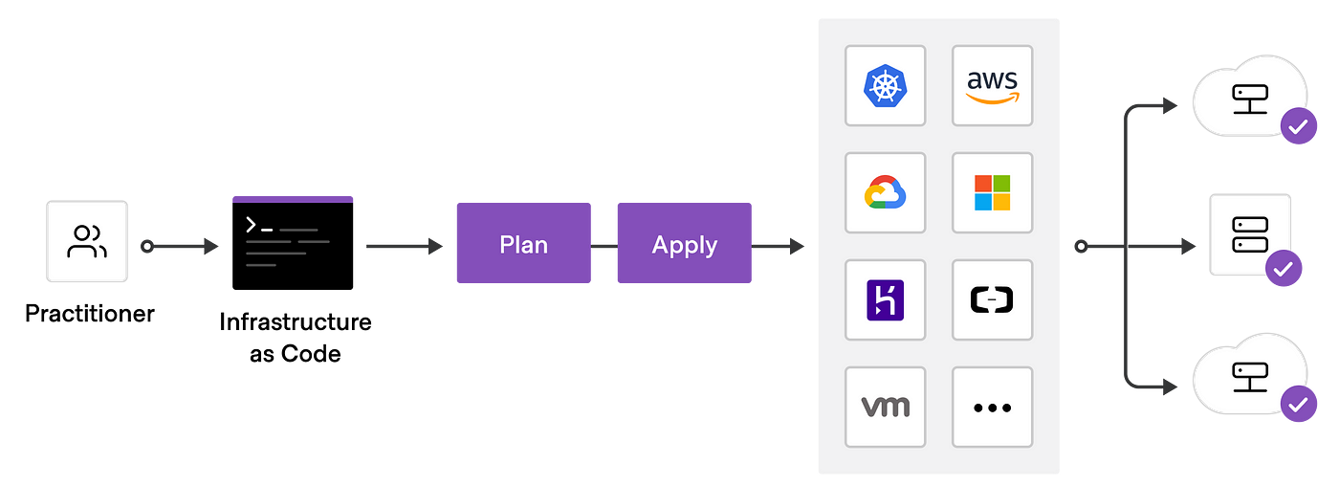
Introduction
HashiCorp Terraform is an infrastructure as code tool that lets you define both cloud and on-prem resources in human-readable configuration files that you can version, reuse, and share.
Through Terraform work-flow we can easily provision and manage all of your infrastructures throughout its lifecycle.
Through Terraform we can manage low-level components like compute, storage, and networking resources, as well as high-level components like DNS entries and SaaS features.

Slide 41
Traditional Way
Infrastructure as Code:
Infrastructure as code (IaC) means managing your IT infrastructure using configuration files.
Benefits:
Cost reduction
Increase in speed of deployments
Reduce errors
Improve infrastructure consistency
Eliminate configuration drift

Slide 42
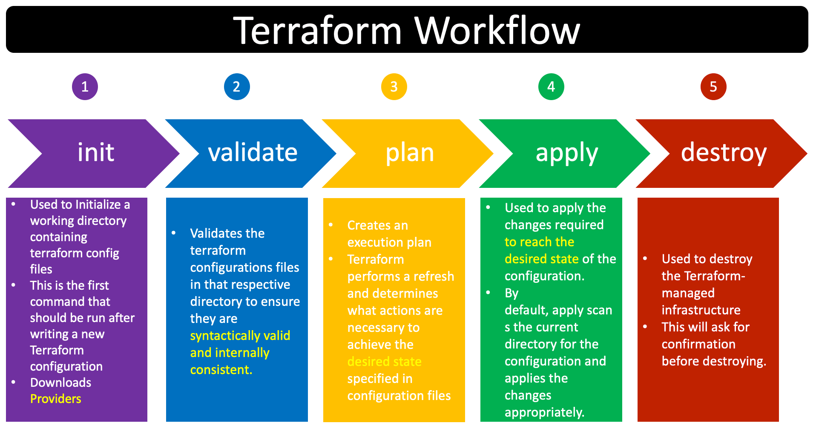

Slide 43
Ansible

Slide 44
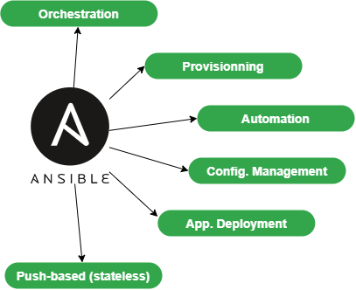

Slide 45
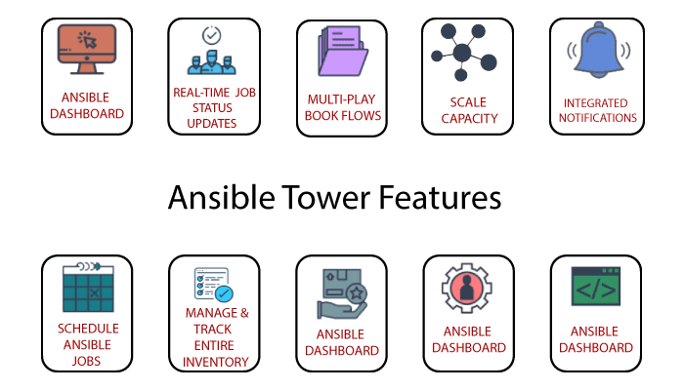

Slide 46
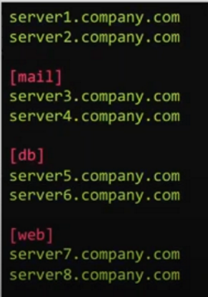
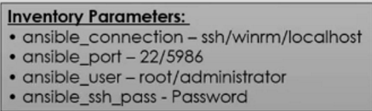

Ansible Inventory: Inventory defined the list of managed nodes you automate, with groups you can run automation tasks on multiple hosts at the same time

Slide 47
Kubernetes

Slide 48
Container Management:
Container management is a process for automating the creation, deployment, and scaling of containers.
Container management facilitates the addition, replacement, and organization of containers on a large scale.
What is a Container?
A container is a lightweight package that bundles together a single app and its dependencies to make applications easier to develop, deploy and manage across complex IT environments.
Container Runtime engines:
Docker
Containerd
Cri-O
Rklet
Kubernetes CRI
Benefits
Rollbacks/Rollouts
Batch execution
Load Balancing
Monitoring
Scheduling
Deploying
Auto Scaling
Few well-known container management tools:
Kubernetes Openshift
Docker Swarm Apache Mesos Marathon

Slide 49
Kubernetes
Container management (orchestration) tool
Developed by google lab (CNCF) Cloud Native Computing Foundation
Open Source
Written on Golang
Also known as K8s
Features:
Automatic bin packing:
  It automatically packages your application and schedules the container based on requirements and resources available.
Service discovery and load balancing:
  It can control over network and communication between pods and can load balance across them.
Storage Orchestration:
  AWS (EBS) AWS S3/NFS/Azure (Blob) — It allows you to mount the storage system of your choice.

Slide 50
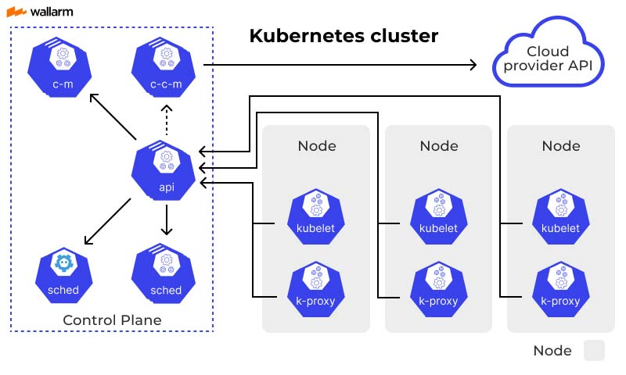
ETCD

Slide 51
API Server: The API server is a component of the Kubernetes control plane that exposes the Kubernetes API.
ETCD: Consistent and highly-available key-value store used as Kubernetes' backing store for all cluster data.
Scheduler: Control plane component that watches for newly created Pods with no assigned node, and selects a node for them to run on.
Control Manager: Control plane component that runs controller processes
  Node controller: Responsible for noticing and responding when nodes go down.
  Job controller: Watches for Job objects that represent one-off tasks, then creates Pods to run those tasks to completion.
  Endpoints controller: Populates the Endpoints object (that is, joins Services & Pods).
Kubelet: An agent that runs on each node in the cluster. It makes sure that containers are running in a Pod.
Kube-Proxy: Kube-proxy is a network proxy that runs on each node in your cluster, implementing part of the Kubernetes Service concept.
Container Runtime: The container runtime is the software that is responsible for running containers.

Slide 52
A Kubernetes Deployment is a powerful, high-level resource that provides a declarative way to manage a set of identical Pods. It is the most common resource used to run a stateless application on a Kubernetes cluster.
Think of a Deployment as the manager for your application. You tell it the desired state of your application (e.g., "I need 3 replicas of the NGINX container"), and the Deployment ensures that state is maintained, even if pods fail.
Core Purpose and Key Benefits
Deployments are essential because they introduce automation and resilience to your applications.
Self-Healing: If a pod crashes, the Deployment automatically detects the failure and starts a new pod to replace it, ensuring the desired replica count is always met.
Scaling: You can easily scale your application up or down by changing the number of replicas, either by a single command or by updating your YAML file.
Rolling Updates: Deployments handle rolling out new versions of your application with zero downtime. It replaces pods one by one, ensuring the application remains available throughout the update process.
Rollbacks: If a new update causes an issue, a Deployment allows you to easily revert to a previous, stable version of your application with a single command.
Declarative Management: The entire state of your application is defined in a YAML file, which can be stored in version control (like Git) and is repeatable across different environments.

Slide 53
A Kubernetes Service is an abstract way to expose an application running on a set of Pods as a network service. A Service provides a single, stable IP address and DNS name that clients can use to access the application, regardless of which individual pods are running or where they are located.
ClusterIP:
Purpose: This is the default and most basic service type. A ClusterIP service exposes the pods on an internal IP address inside the cluster.
Access: It is only reachable from within the cluster. It is not accessible from the internet or outside the AKS virtual network.
NodePort:
Purpose: A NodePort service exposes the pods on a static port on every node's IP address. Kubernetes automatically allocates a random port (usually in the range 30000-32767) on each node.
Access: It is accessible from outside the cluster using <NodeIP>:<NodePort>. However, traffic must be routed to the node's IP address directly.
LoadBalancer
Purpose: This service type is designed for cloud environments like Azure AKS. When you create a LoadBalancer service, Azure's infrastructure automatically provisions a dedicated Azure Load Balancer.
Access: It provides a single, stable public IP address that is accessible from anywhere on the internet. The Azure Load Balancer then distributes incoming traffic to the pods behind the service.

Slide 54
Helm Charts

Slide 55
Helm charts are packages (like rpms). It contains pre-configured Kubernetes resources such as
  ConfigMaps
  Deployments
  Services
Helm is the package manager for Kubernetes (like yum) that allows easily package, configure, and deploy applications onto Kubernetes clusters.
Architecture: Helm installs charts into Kubernetes, creating a new release for each installation. And to find new charts, you can search Helm chart repositories.
Repository is the place where charts can be collected and shared.
Chart is a Helm package. It contains all of the resource definitions necessary to run an application on Kubernetes Cluster.
Release is an instance of a chart running in a Kubernetes cluster.

Slide 56
Istio

Slide 57
Istio is an open framework for connecting, securing, managing and monitoring microservices.
Istio include
  discovery
  load balancing
  failure recovery
  metrics
  monitoring
Istio can also handle more complex operational requirements,
  A/B testing,
  canary releases,
  rate limiting,
  dark launches,
  access control,
  end-to-end authentication
What makes Istio so unique is that all these functionalities come with NO CHANGE OF CODE required.

Slide 58
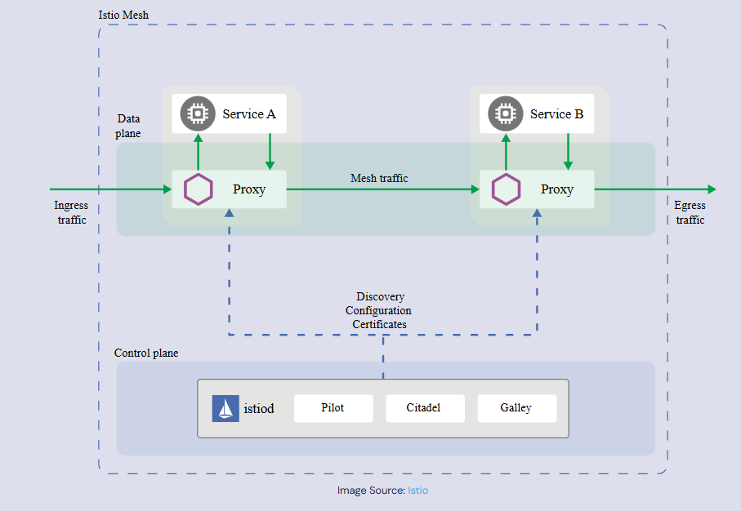
Architecture

